Slide 1
Machine Performance Tool
Michael Harris & John Mathews

Slide 2
Background
General Topic:
Develop an open source tool (command-line or visual) that monitors system performance or network performance.
Our Project:
We have created a command-line tool for Ubuntu Linux Distributions that tells the user in depth information about system hardware and allows them to control certain aspects of the system processes.
Project Demonstration:
https://youtu.be/CoIdFFmD2GY

Slide 3
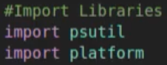
Python Libraries
psutil:
Psutil (process and system utilities) is a cross-platform library for retrieving information on running processes and system utilization (CPU, memory, disks, network, sensors) in Python. It is useful mainly for system monitoring, profiling and limiting process resources and management of running processes. It implements many functionalities offered by classic UNIX command line tools such as ps, top, iotop, lsof, netstat, ifconfig, free and others.
platform:
The Platform module is used to retrieve as much possible information about the platform on which the program is being currently executed. Now by platform info, it means information about the device, it’s OS, node, OS version, Python version, etc. This module plays a crucial role when you want to check whether your program is compatible with the python version installed on a particular system or whether the hardware specifications meet the requirements of your program.

Slide 4
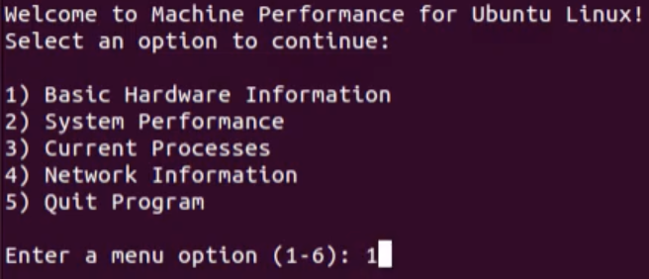
Machine Performance Main Menu
Purpose:
The main menu controls feature or application selection and also allows an option for exiting the program
This menu keeps the flow of functionality efficient and organized, while displaying the allowable actions to the user of the program
Options:
Basic Hardware Information
System Performance
Current Processes
Network Information
Quit Program

Slide 5
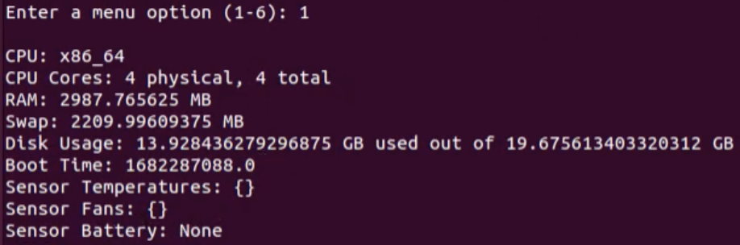
1.0) Basic Hardware Information
Purpose:
Displays general hardware information about the current machine the program is running on
This information can be used to determine the hardware capabilities of the current machine or to allow users to find out what their machine consists of and works with
Information:
CPU: Type of CPU for the machine
CPU Cores: Number of cores in the CPU
RAM: Total Random Access Memory(RAM) space in MB
Swap: Total Swap memory space in MB
Disk Usage: Ratio between used space and total space on the disk in GB
Boot Time: Amount of time it takes to boot the machine
Sensor Temperatures: Temperature of sensors in the machine
Sensor Fans: Number of fans in the machine
Sensor Battery: Number of sensor batteries in the machine

Slide 6
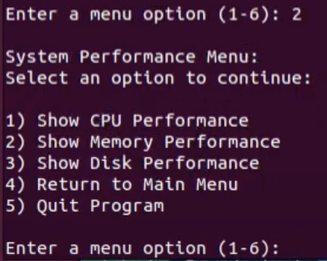
2.0) System Performance Menu
Purpose:
The System Performance Menu controls feature selection for the System Performance section of the application
This menu keeps the flow of functionality efficient and organized, while displaying the allowable actions to the user in terms of the System Performance capabilities
Options:
Show CPU Performance
Show Memory Performance
Show Disk Performance
Return to Main Menu
Quit Program

Slide 7
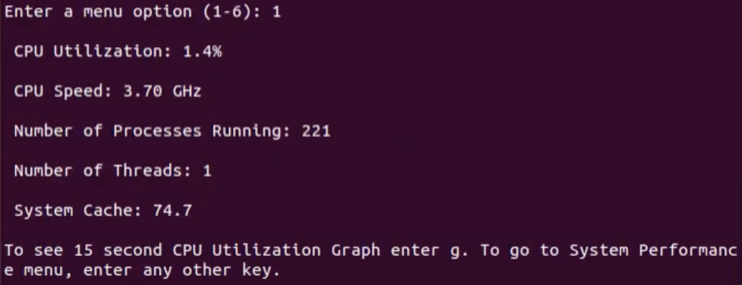
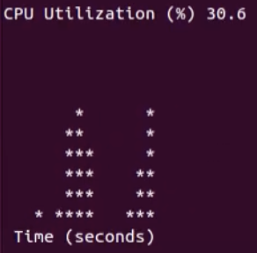
2.1) Show CPU Performance
Purpose:
Displays the current performance of the machine’s CPU
This information can be used to understand how much load the machine is taking and how efficiently it is currently running
Information:
CPU Utilization: Percentage of CPU currently in use
CPU SPeed: Overall speed of the CPU in GHz
Number of Processes: Total count of processes running on the machine
Number of Threads: Total count of threads running on the machine
System Cache: Amount of CPU cache in use
Options:
Output a 15 second range CPU Utilization ASCII graph by pressing g

Slide 8
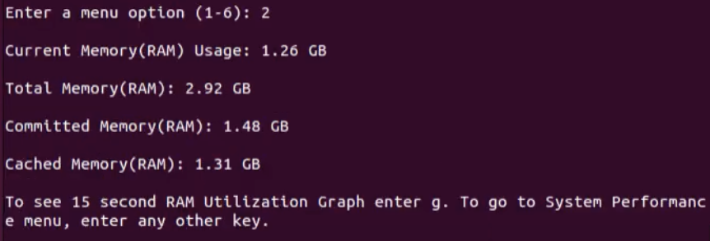
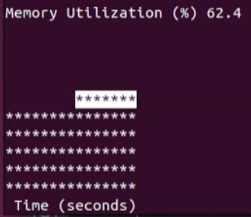
2.2) Show Memory Performance
Purpose:
Displays the current allocation of the machine’s memory
This information can be used to understand how much load the machine is taking and if memory space is getting full
Information:
Current Memory Usage: Amount of used RAM memory in GB
Total Memory: Amount of total RAM memory in GB
Committed Memory: Amount of committed RAM memory in GB
Cached Memory: Amount of cached RAM memory in GB
Options:
Output a 15 second range RAM Utilization ASCII graph by pressing g

Slide 9
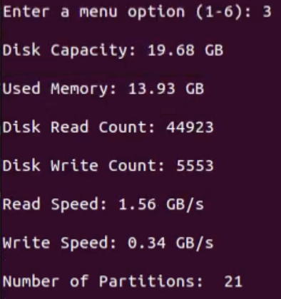
2.3) Show Disk Performance
Purpose:
Displays the current allocation of the machine’s disk
This information can be used to understand how much load the machine is taking and if memory space is getting full
Information:
Disk Capacity: Total amount of disk space in GB
Used Memory: Used amount of disk space in GB
Disk Read Count: Total amount of disk reads
Disk Write Count: Total amount of disk writes
Read Speed: Speed of reading in GB/s
Write Speed: Speed of writing in GB/s
Number of Partitions: total number of partitions on the machine

Slide 10
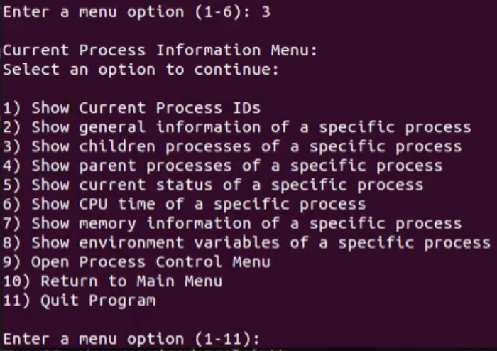
3.0) Current Processes Menu
Purpose:
The Current Processes Menu controls feature selection for the management and information on the machine’s current processes
This menu keeps the flow of functionality efficient and organized, while displaying the allowable actions to the user in terms of the Current Processes functionality and capabilities
Options:
Show Current Process IDs
Show general information about a process
Show children processes of a specific process
Show parent processes of a specific process
Show current status of a process
Show CPU time of a process
Show memory information of a process
Show environment variables of a process
Open Process Control Menu
Return to Main Menu
Quit Program

Slide 11
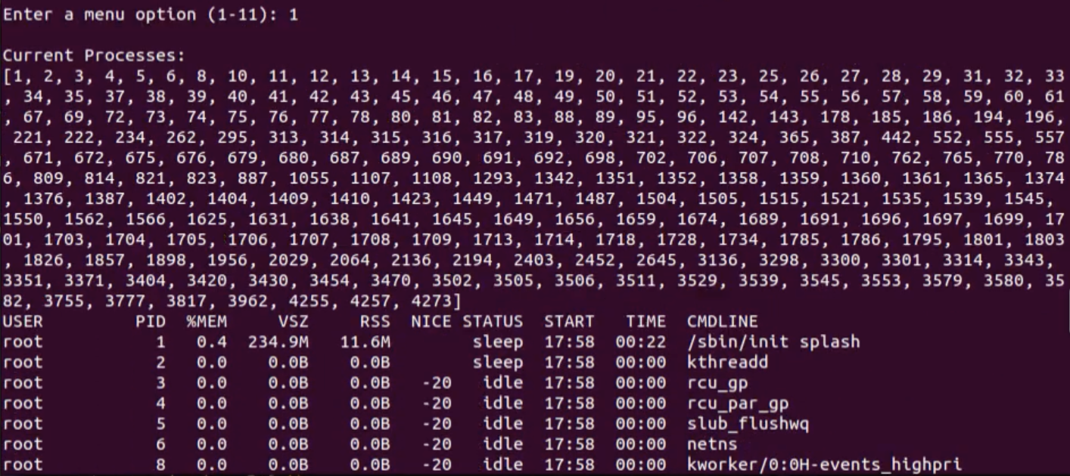
3.1) Show Current Process IDs
Purpose:
Displays all of the current process ID numbers that are on the machine
These can be used to identify specific processes and see basic information about all of them
Information:
List of Current Processes and their IDs
top function call that shows general information about all processes:
Name
PID
Memory Percentage
Virtual Memory Size
Resident Set Size
Nice Value
Status
Start Time
Active Time
File Path

Slide 12
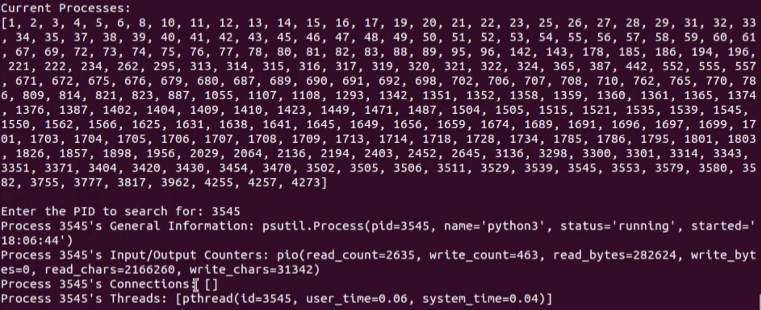
3.2) Show General Information
Purpose:
Allows the user to search for general information about a specific process by inputting the PID
This can be used to find out more about a process and what they’re doing for the machine
Information:
PID
Name
Status
Start Time
Read Count
Write Count
Read Bytes
Write Bytes
Connections
Threads

Slide 13
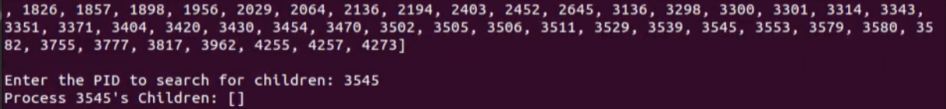
3.3) Show Children Processes
Purpose:
Shows the children processes of a specific process that is inputted by the user
This can be used to find out related processes and stop the occurrence of zombie processes when using the Process Control Menu
Information:
List of all the taken PIDs on the machine
Lists all of the children processes that the given PID possesses
Gives general information about each child

Slide 14
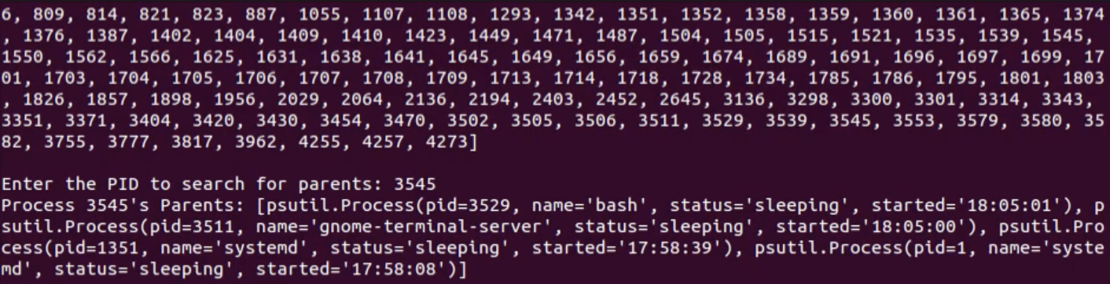
3.4) Show Parent Processes
Purpose:
Shows the parent processes of a specific process that is inputted by the user
This can be used to find out related processes and stop the occurrence of zombie processes when using the Process Control Menu
Information:
List of all the taken PIDs on the machine
Lists all of the parent processes that the given PID possesses
Gives general information about each parent

Slide 15
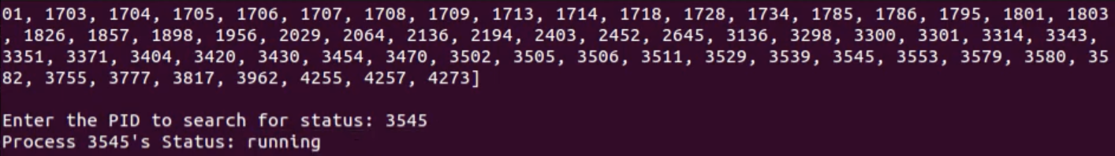
3.5) Show Status of a Process
Purpose:
Shows the current status of a specific process that is inputted by the user
This can be used to find out if a process is currently active or not in order to determine which processes are taking up machine resources
Information:
List of all the taken PIDs on the machine
Reports the current status of the given PID

Slide 16
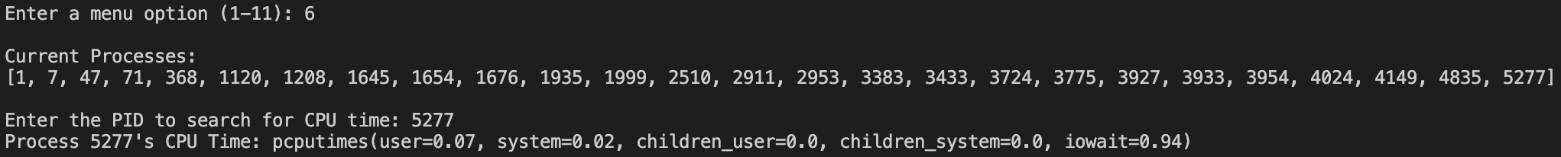
3.6) Show CPU Time of a Process
Purpose:
Shows the total CPU allocation of a specific process that is inputted by the user
This can be used to determine how and where a process is using its allocated CPU resources and limited time in order to determine performance and efficiency on the machine
Information:
List of all the taken PIDs on the machine
Reports the different CPU allocations of the given PID
User, System, Children User, Children System, Input/Output Wait

Slide 17
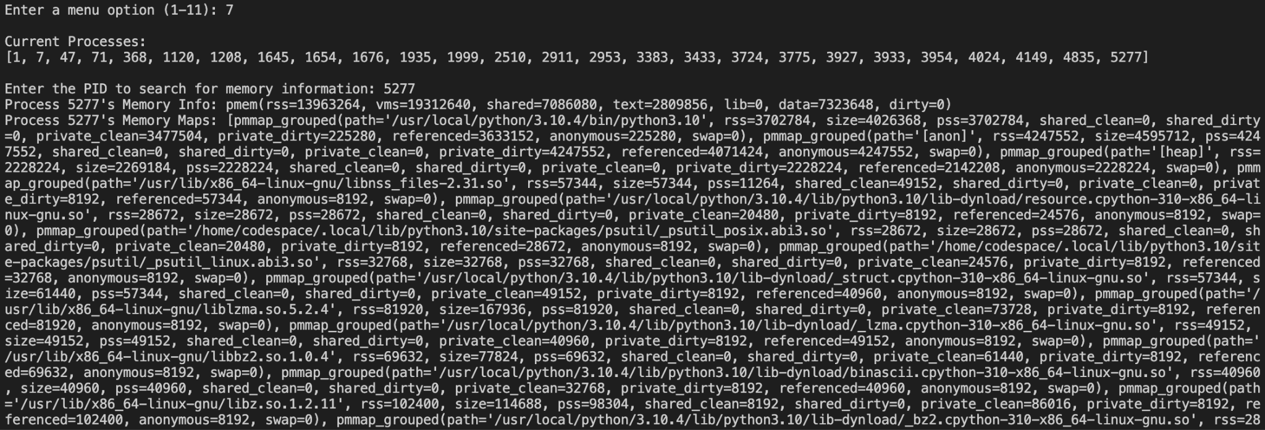
3.7) Show Memory Information
Purpose:
Shows the total memory allocation of a specific process that is inputted by the user
This can be used to determine how and where a process is storing its allocated memory resources in order to determine storage efficiency on the machine
Information:
List of all the taken PIDs on the machine
Lists the different memory allocations of the given PID

Slide 18
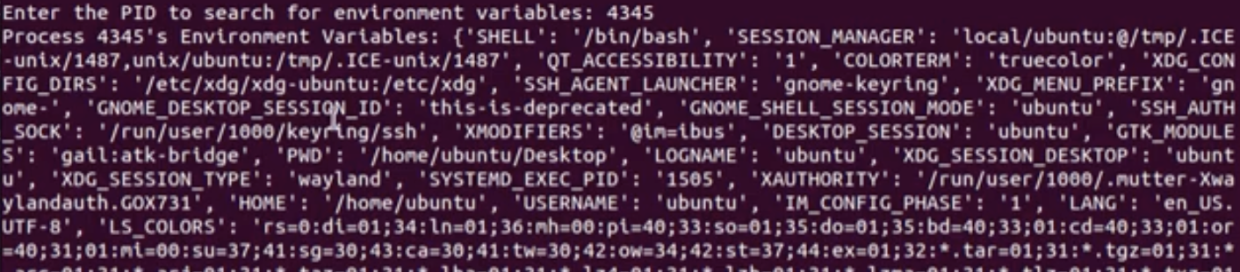
3.8) Show Environment Variables
Purpose:
Shows all of the environment variables of a specific process that is inputted by the user
This can be used to determine the fields of the environment variables for a specific process so they can be modified if needed
Information:
List of all the taken PIDs on the machine
Lists all of the environment variables of the given PID

Slide 19
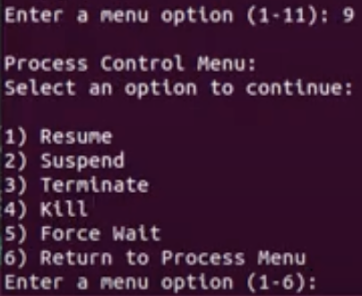
3.9) Process Control Menu
Purpose:
The Process Control Menu controls feature selection for the management of the machine’s current processes
This menu keeps the flow of functionality efficient and organized, while displaying the allowable actions to the user in terms of the Process Control functionality and capabilities
Options:
Resume: Allow a process to continue running
Suspend: Stop a process from running
Terminate: Clean exit a process from running
Kill: Force exit a process from running
Force Wait: Enter the amount of wait time to force upon a process

Slide 20
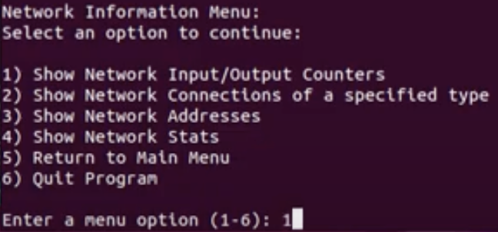
4.0) Network Information Menu
Purpose:
The Network Information Menu controls feature selection for the information of the machine’s network state
This menu keeps the flow of functionality efficient and organized, while displaying the allowable actions to the user in terms of the Network Information functionality and capabilities
Options:
Show Network Input/Output Counters
Show Network Connections of a specified type
Show Network Addresses
Show Network Stats
Return to Main Menu
Quit Program

Slide 21

4.1) Show Input/Output Counters
Purpose:
Shows basic information about the network input and output statistics and values
This can be used to determine how the network of the machine is operating and if it is working efficiently and properly
Information:
Different Connections
Bytes Sent
Bytes Received
Packets Sent
Packets Received
Errors In/Out
Packets Dropped In/Out

Slide 22
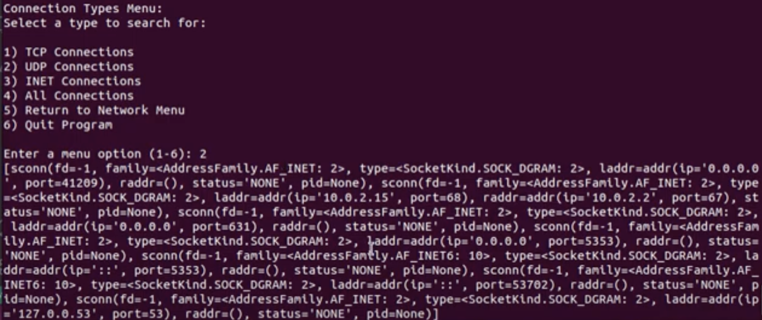
4.2) Different Network Connections
Purpose:
Shows all network connections on the machine of the user-specified type
This can be used to determine how the network of the machine is operating and what types of connections are more frequent and used
Information:
IP Address
Port
Family
Type
Status
PID
Options:
TCP Connections
UDP Connections
INET Connections
All Connections
Return to Network Menu
Quit Program

Slide 23
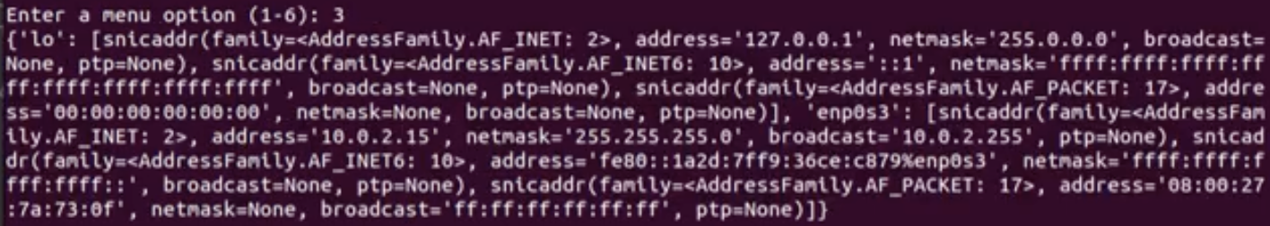
4.3) Show Network Addresses
Purpose:
Shows network address information about all connections attached to the machine
This can be used to determine how many connections are on the machine and what they are actually doing
Information:
Different Connections
Type
Family
IP Address
Network Mask
Broadcast Mask
Precision Time Protocol

Slide 24

4.4) Show Network Stats
Purpose:
Shows network statistic information about all connections attached to the machine
This can be used to determine how many connections are on the machine and the statistics of each of those connections
Information:
Different Connections
Status
Speed
Flags
Duplex Communication System
Maximum Transmission Unit

Slide 25
Thank you!
Questions?

